Slide 1

Hackathon de agentes de IA
8 de abril – 30 de abril
¡Crea, innova y #HackeamosJuntos! aka.ms/agentshack-es
En asociación con
Notes:
Welcome to the AI Agents hackathon live streams!
The AI Agents hack is a free virtual event running from April 8-30.

Slide 2
¡Cuatro semanas de aprendizaje!
aka.ms/agentshack-es
7
MONDAY
8
TUESDAY
9
WEDNESDAY
10
THURSDAY
11
FRIDAY
12
SATURDAY
13
SUNDAY
Week 1
Bienvenidos!
Azure AI Agent
Java Agents
M 365 Copilots
Semantic Kernel
.NET Agents
Hack!
Hack!
Hack!
14
MONDAY
15
TUESDAY
16
WEDNESDAY
17
THURSDAY
18
FRIDAY
19
SATURDAY
20
SUNDAY
Hack!
JS Agents
AutoGen
.NET Agents
Azure Agents
Cosmos DB
Azure AI Models
Azure Models Semantic Kernel
Langchain4J
Hack!
Hack!
Hack!
Week 2
21
MONDAY
22
TUESDAY
23
WEDNESDAY
24
THURSDAY
25
FRIDAY
26
SATURDAY
27
SUNDAY
Week 3
Llamaindex.TS
GitHub Models
Prompty
Azure SQL
Agentes Grupales
VoiceRAG
PostgreSQL
Azure Functions
Real-time ACS
Robotic agents
Hack!
Hack!
Hack!
28
MONDAY
29
TUESDAY
30
WEDNESDAY
También hay un horario de atención en Discord durante la semana.
aka.ms/agentshack/discord
transmisión en español
Week 4
Hack!
Responsible AI
Securing Agents
Evaluation
Envía tu hack!
11:59 PM PT
Notes:
We’re hosting over 20 live streams where you’ll learn how to build agents using various Microsoft technologies. At the end of the three weeks, submit your project for a chance to win fantastic prizes!
Now, let’s hear from our friends at Reactor...

Slide 3
Transmisiones en vivo en cuatro idiomas
English:
aka.ms/agentshack
Portuguese:
aka.ms/agentshack-pt
Chinese:
aka.ms/agentshack-zh
Semantic Kernel
Autogen
Langchain4J
Llamaindex.TS
Azure Functions
Azure Container Apps
Azure Cosmos DB
Azure SQL
Azure AI Agents - Python
Azure AI Agents - JavaScript
欢迎参加AI代理黑客松
使用Azure AI Agent Service作为您的软件开发流程

Slide 4
Premios 🏆
El monto del premio es por equipo, no por miembro del equipo
Categoría | Premio
Mejor agente en General | $20,000
Mejor agente en Python | $5,000
Mejor agente en C# | $5,000
Mejor agente en Java | $5,000
Mejor agente en JavaScript/TypeScript | $5,000
Mejor agente Copilot (con Microsoft Copilot Studio o 365 Agents SDK) | $5,000
Mejor uso de Servicio de Agentes de Azure AI | $5,000

Slide 5
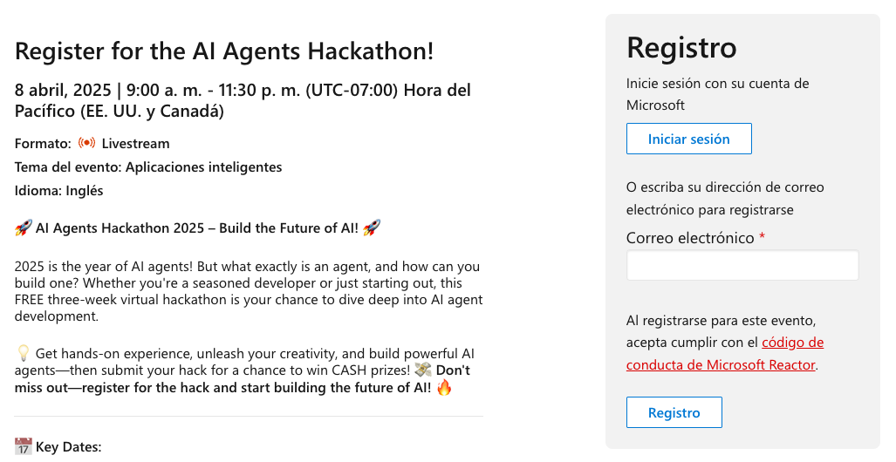
Registro
Regístrate para ser elegible a los premios:
https://aka.ms/agentshack/register

Slide 6
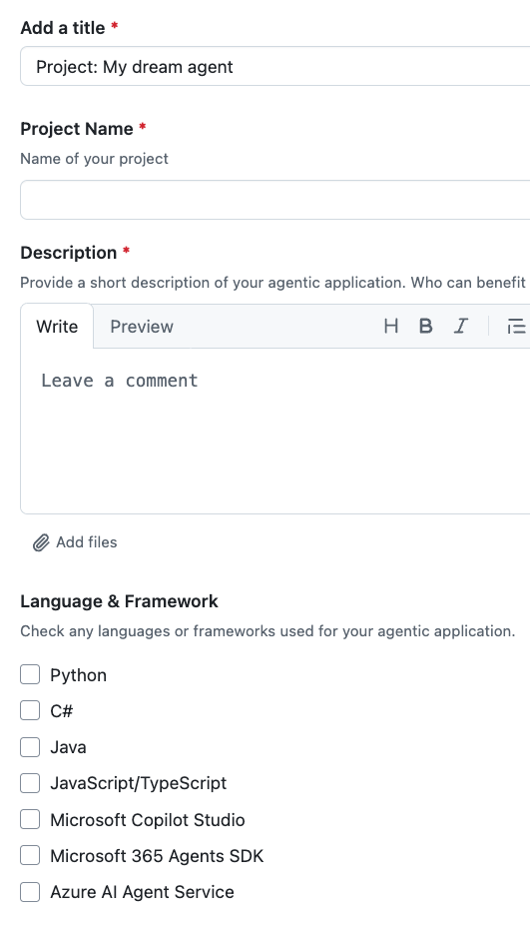
Proceso de envío
Asegúrese de que usted y todos los miembros del equipo (hasta 4 en total) estén registrados para el hackathon.
Antes del 30 de abril a las 11:59 p. m. PST, envíe su hack usando el proceso descrito @ https://aka.ms/agentshack/submit Se requiere una URL del repositorio del proyecto y un video de demostración breve.
Espere unas semanas a que los jueces terminen de calificar. Notificaremos a todos los participantes cuando se anuncien los ganadores.

Slide 7
Preguntas??
Puedes publicar en el foro:
https://aka.ms/agentshack-es/recursos-preguntas
O en el canal de Discord:
https://aka.ms/agentshack/discord

Slide 8
Agents 101

Slide 9
Introducción a los agentes
Frameworks
de agentes de IA
Patrones de diseño
Agentes de IA
Uso de
herramientas
Para principiantes
Agentic RAG
Fiabilidad
Planificación
Multi-agentes
Metacognición
Agentes en
Producción
aka.ms/ai-agents-beginners
Notes:
This part of the presentation is based in free agents curriculum that's available online, and is translated into portuguese too.
You can dive way more into these concepts after this talk from that link.

Slide 10
¿Qué puedes construir?
Notes:
Let's look at an example of what an agent can look like.

Slide 11






Demo: Contoso Creative Writer
Azure Monitor
Flujo multiagente
Agente investigador
Azure OpenAI Service
Grounding with Bing
Azure AI Search
Agente de producto
Entrada del usuario
Azure Container Apps (ACA)
Respuesta
Azure OpenAI Service
Azure AI Search
Agente escritor
Azure OpenAI Service
Agente editor
https://aka.ms/creative-writer-agent
Azure OpenAI Service
Notes:
Here's a relatively simple multi-agent flow, involving a writer, researcher, and editor.

Slide 12

Demo: Asistencia bancaria
Azure Container Apps (ACA)
Agente de cuentas
Intent=AccountInfo
Azure
OpenAI
Herramientos
AccountServiceClient
Respuesta
Agente de enrutador
Agente de transacciones
Usuario
Intent=Transactions
Herramientos
Azure
OpenAI
Azure
OpenAI
Pregunta o acción respecto a cuenta bancaria personal, transacciones, pago de facturas
ReportingServiceClient
AccountServiceClient
Intent=PayInvoice,
RepeatPayment
Agente de pagos
Azure
OpenAI
Herramientos
AccountServiceClient
ReportingServiceClient
PaymentServiceClient
ScanInvoice
https://github.com/Azure-Samples/agent-openai-java-banking-assistant
Notes:
Here's a relatively simple multi-agent flow, involving a writer, researcher, and editor.

Slide 13
¿Qué es un agente de IA?
Notes:
So that was an example of an agent, but what actually is an agent? It can be hard to define, but we'll try!

Slide 14
Un agente de IA es una entidad de software semiautónoma que aprovecha grandes modelos de lenguaje para realizar tareas específicas a través del lenguaje natural.
Notes:
Here's one definition:
Un agente de IA es una entidad de software semiautónoma que aprovecha grandes modelos de lenguaje para realizar tareas específicas a través del lenguaje natural.

Slide 15
Modelo de lenguaje grande
Realiza
acciones
Acceso a
Herramientas
Conocimiento
Notes:
Here's another way of visualizing an agent:
an LLM that can perform actions, has access to tools, and has access to knowledge.
Large Language Models - The concept of agents existed before the creation of LLMs. The advantage of building AI Agents with LLMs is their ability to interpret human language and data. This ability enables LLMs to interpret environmental information and define a plan to change the environment.
Perform Actions - Outside of AI Agent systems, LLMs are limited to situations where the action is generating content or information based on a user's prompt. Inside AI Agent systems, LLMs can accomplish tasks by interpreting the user's request and using tools that are available in their environment.
Access To Tools - What tools the LLM has access to is defined by 1) the environment it's operating in and 2) the developer of the AI Agent. For our travel agent example, the agent's tools are limited by the operations available in the booking system, and/or the developer can limit the agent's tool access to flights.
Memory+Knowledge - Memory can be short-term in the context of the conversation between the user and the agent. Long-term, outside of the information provided by the environment, AI Agents can also retrieve knowledge from other systems, services, tools, and even other agents. In the travel agent example, this knowledge could be the information on the user's travel preferences located in a customer database.
That combination is very powerful and can help us automate many flows.

Slide 16
¿Cuándo utilizar agentes de IA?
Notes:
Let's look at some examples of when you'd want to use agents.

Slide 17
¿Cuándo utilizar agentes de IA?
Problemas abiertos
Procesos
de varios pasos
Mejora
con el tiempo
Notes:
These are three situations where agents can be beneficial:
Open-Ended Problems - If you have an open-ended problem, it can be hard to program with traditional if/else statements because it's not always clear what task should be tackled next. Instead, you can use an LLM to make the planning decisions.
Multi-Step Processes - These are tasks that require a level of complexity in which the AI Agent needs to use tools or information over multiple turns instead of single shot retrieval.
Improvement Over Time - These are tasks where the agent can improve over time by receiving feedback from either its environment or users in order to provide better utility.

Slide 18




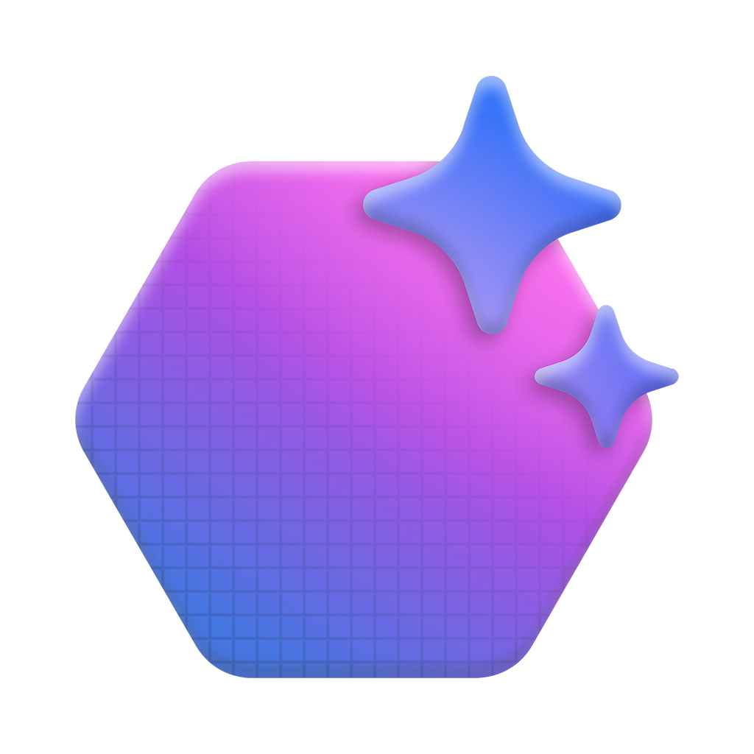


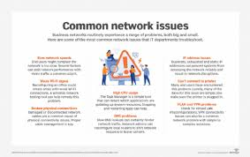
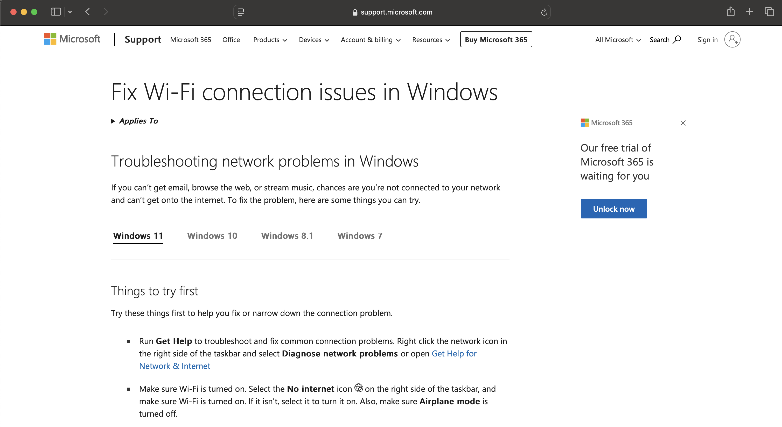
Ejemplo de agente Asistencia del centro de llamadas
Plan dinámico
1. Agente de documentación → Busque en la documentación de soporte interno el código de error "E-22" y la solución de problemas de Wi-Fi.
2. Video Agent → Busque y marque con fecha y hora la resolución de problemas de contenido de video relacionados con la conexión Wi-Fi y el código de error E-22.
3. Agente de investigación web → Busque en fuentes externas debates recientes, sugerencias o problemas específicos de productos relacionados con Wi-Fi y códigos de error.
Pensamiento basado en la observación:
¿Encontré los datos relevantes para ayudar al agente?
Pensamiento
Pregunta del cliente
Buscar documentos
Mi termostato SmartHome no se conecta a Wi-Fi y sigo viendo un código de error E-22. ¿Cómo puedo solucionar esto?
Análisis de pregunta
{ Wi-Fi }
Planificador
Azure AI Agent Service
Plan
Acción
Buscar y anotar
vídeos
LLM
{ Error: E-22 }
AutoGen o Semantic Kernel
{ Thermostat X10 }
Buscar en la web
Observación
Agente de vídeo
Agente de docs
Agente de Web
Azure AI Agent Service
Azure AI Agent Service
Azure AI Agent Service
* Podemos usar o serviço Azure AI Content Understanding para extrair imagens e vídeos e transformá-los de dados não estruturados em dados estruturados
Reanudar videos
relacionados con Wi-Fi y
código de error E-22.
Encuentre los últimos recursos externos relacionados con el tema
Encuentra pasos para solucionar problemas internos.
Notes:
Let's look at a specific example, an assistant for a call center. This system demonstrates how agents can collaborate dynamically to solve customer queries. The system starts with a query parsing agent, which interprets the user's request. The Planner agent then breaks down the task into specific sub-tasks, while agents like Doc and Web Search pull relevant documentation and online resources to assist the customer.
This dynamic, real-time orchestration of tasks by multiple agents enables the handling of complex customer service queries. The process is continuously evaluated by the system, ensuring the relevant data is fetched and presented in an actionable format.

Slide 19
¿Cómo empezar a crear agentes de IA?

Slide 20
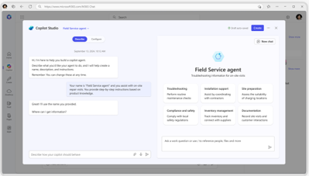
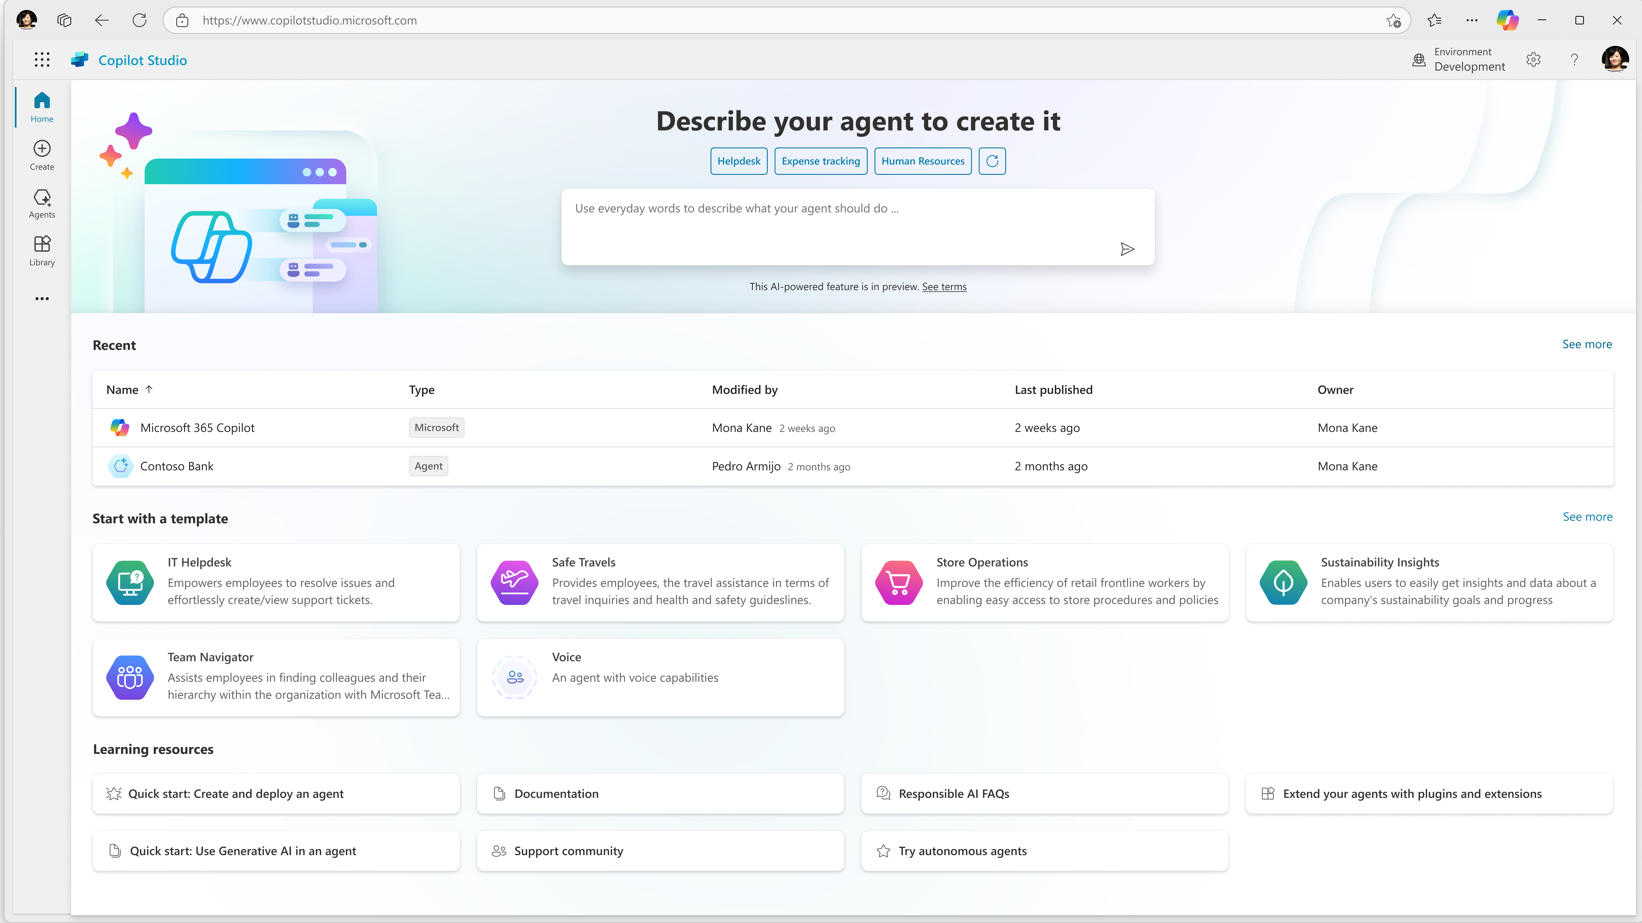
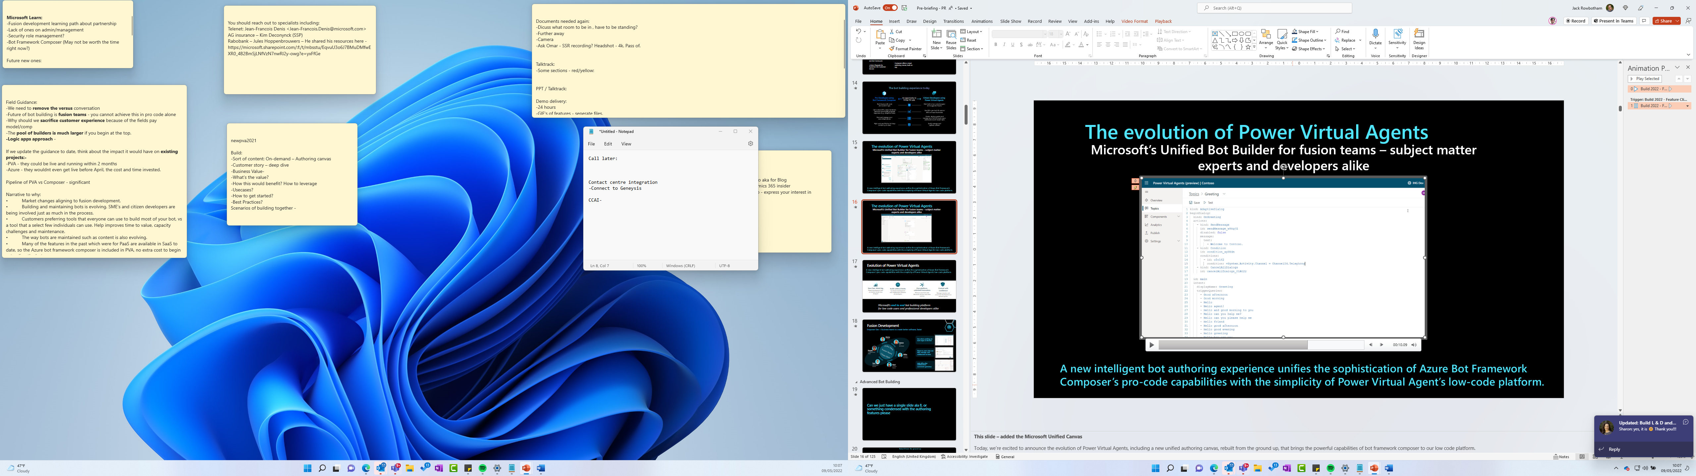




Herramientas para construir tu primer agente
Lenguaje natural
Código
Agent builder
Copilot Studio
Copilot Studio + Visual Studio/GitHub
Para usuarios
Para creadores
Com el Azure AI Agent Service
Para desarrolladores
Notes:
Microsoft offers different tools for getting started, depending on your level of technical skill. For all users, there's the Agent builder, which is a no-code option for making custom Copilots. For users that are a bit more technical (but perhaps not software engineers), Copilot Studio is a way to build Copilots with minimal code, but more flexibility. Finally, for developers, Copilot Studio integrates with Visual Studio Code and allows you to customize your Copilot agent much more.

Slide 21



1
Agente único
2
Multiagente
Crear con
Azure AI Agent Service
Orquestarlos juntos con AutoGen e Semantic Kernel
Microservicio
de agente
administrado
SDK de
investigación
SDK estable y
listo para producción
Ideación
Producción
Notes:
Developers always ask what AI Agent frameworks to use for coding your first agent.
For a single agent scenario, Microsoft offers the Azure AI Agent service and SDK, which basically creates a microservice for your agent, complete with thread storage.
For multi-agent scenarios, Microsoft offers two libraries that can make orchestration easier:
Autogen, from Microsoft Research, which includes state-of-the-art orchestration strategies
Semantic Kernel, which is designed more for production scenarios but brings in some of the strategies from AutoGen

Slide 22
Pero ¿cómo se crean buenos agentes de IA?
Notes:
Okay, but there's a difference between making an agent and making a *good* agent. What are the characteristics of a high-quality agent? Let's explore!

Slide 23
Principios de diseño de agentes
Espacio
Tiempo
Núcleo
Notes:
Let's go through these three design principles: Space, Time, and Core.
Agent (Space)
This is the environment in which the agent operates. These principles inform how we design agents for engaging in physical and digital worlds.
Connecting, not collapsing – help connect people to other people, events, and actionable knowledge to enable collaboration and connection.
Agents help connect events, knowledge, and people.
Agents bring people closer together. They are not designed to replace or belittle people.
Easily accessible yet occasionally invisible – agent largely operates in the background and only nudges us when it is relevant and appropriate.
Agent is easily discoverable and accessible for authorized users on any device or platform.
Agent supports multimodal inputs and outputs (sound, voice, text, etc.).
Agent can seamlessly transition between foreground and background; between proactive and reactive, depending on its sensing of user needs.
Agent may operate in invisible form, yet its background process path and collaboration with other Agents are transparent to and controllable by the user.
Agent (Time)
This is how the agent operates over time. These principles inform how we design agents interacting across the past, present, and future.
Past: Reflecting on history that includes both state and context.
Agent provides more relevant results based on analysis of richer historical data beyond only the event, people, or states.
Agent creates connections from past events and actively reflects on memory to engage with current situations.
Now: Nudging more than notifying.
Agent embodies a comprehensive approach to interacting with people. When an event happens, the Agent goes beyond static notification or other static formality. Agent can simplify flows or dynamically generate cues to direct the user’s attention at the right moment.
Agent delivers information based on contextual environment, social and cultural changes and tailored to user intent.
Agent interaction can be gradual, evolving/growing in complexity to empower users over the long term.
Future: Adapting and evolving.
Agent adapts to various devices, platforms, and modalities.
Agent adapts to user behavior, accessibility needs, and is freely customizable.
Agent is shaped by and evolves through continuous user interaction.
Agent (Core)
These are the key elements in the core of an agent’s design.
Embrace uncertainty but establish trust.
A certain level of Agent uncertainty is expected. Uncertainty is a key element of agent design.
Trust and transparency are foundational layers of Agent design.
Humans are in control of when the Agent is on/off and Agent status is clearly visible at all times.

Slide 24
¿Qué son los patrones de diseño para agentes de IA?
Notes:
Now let's look at design *patterns*: common ways of designing agentic flows to incorporate tools, knowledge, and actions.

Slide 25






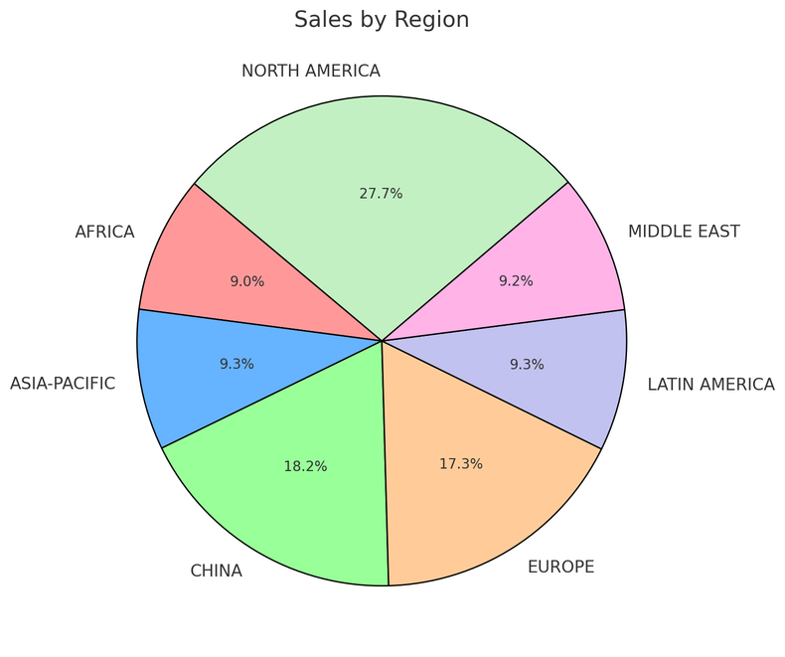
Uso de herramientos en conversaciones
Conversación
Ejecución #1
Agente de ventas
Mensaje de usuario
Dime las ventas totales por región
Instrucciones: Usted es un agente de análisis de ventas avanzado en Contoso, especializado en ayudar a los usuarios con consultas de datos de ventas.
1
Consultar SQLite DB
SELECT * FROM
sales GROUP BY region
Mensaje del agente
Aquí están las ventas:
Europa: $15,478.00
Estados Unidos: $78,792.00
2
Crear mensaje
Modelo
Herramientos
File Search Code Interpreter
Query SQLite Bing Search Microsoft SharePoint
Microsoft Fabric Azure Logic Apps
Azure Functions
Mensaje de usuario
Mostrar como un gráfico circular
Ejecución #2
Code Interpreter Tool
Create a pie chart
Datos
1
Mensagem do agente
Azure AI Search
Files (Azure Blob)
2
Crear mensaje
Notes:
This slide has lots of annimations
So, a bit more of a drill down
High level – this is how the AI Agent Service works
Create/define agent,
Create a thread which is a unit of conversation
Run the Agent
Check status till complete
Show output
Break this down futher

Slide 26

Uso de herramientas en Agentic RAG
Documentos
Pregunta de usuario
Base de datos
Comprobar
la calidad
Recopilar resultados
Análisis
por LLM
APIs internas
Búsqueda web
✅ Buena calidad
❌ Insuficiente
Actualizar memoria
Gerar resposta
Notes:
RAG, Retrieval-Augmented Generation, is a way of getting an LLM to answer questions about your own data, by first retrieving relevant context and sending that to the LLM. There are many ways that we can improve RAG through agentic design patterns to increase the accuracy of the answers.
In this diagram, we send the user question to an LLM for initial analysis. It decides what tools to call and how to call them in order to find results, searching multiple places for relevant information. Then we collect the results together, and use either a model or algorithm to decide if the quality is high enough. If not, we repeat the retrieval step, but if so, we send the results to the LLM to generate a response. Finally, we remember the interaction in memory, for future reference.

Slide 27
Model Context Protocol
Una forma estándar en la que las aplicaciones pueden proporcionar contexto y herramientas para los LLM
MCP Host
Claude, GitHub Copilot, ...
MCP Server A
MCP Client A
MCP
Tools
Prompts
Resources
MCP Server B
MCP Client B
MCP
Datos
remotos
Tools
Prompts
Resources
https://modelcontextprotocol.io/

Slide 28
Construyendo agentes de IA confiables
Notes:
If we're going to use agents for business automation – to actually take actions – we need a high degree of confidence in their accuracy.

Slide 29
Estrutura de mensagem do sistema
Mensaje del sistema
Agente
Mensaje del sistema
a generar
mensajes del sistema
Mensaje del sistema
Agente
Mensaje del sistema
Agente
LLM
Mensaje básico del sistema
Mensaje del sistema
Agente
Notes:
https://learn.microsoft.com/azure/ai-services/openai/concepts/system-message?tabs=top-techniques

Slide 30
Interacción con humanos ("Human-in-the-loop")
Objetivo del usuario
Objetivo del usuario completado por el agente
Agente de usuario
Respuesta enviada
para el agente de usuario
La tarea es
completa o continua
Agente
de IA
Agente
de IA
Notes:
For systems that need high accuracy, we will often need a way to bring in humans. A human can provide missing information, it can approve any actions that have low confidence, it can interact with users that are having a hard time getting what they need from an agent (like for customer support). Even if we bring humans in to handle 5% of cases, using AI agents can still help us speed up 95% of a business process.

Slide 31
Evaluación de agentes de IA
Pregunta de usuario
"¿El tiempo para mañana?"
Resolución de intención
El usuario desea saber el clima local para su ubicación.
Llamadas de herramientas
Llamar API de ubicación
Llamar API de clima
Respuesta final
"La temperatura será de 30 grados. La lluvia..."
Identificación de intención del usuario
Aclaración de la ambigüedad
Selección correcta de llamada de herramienta
Extracción correcta de parámetros
Adherencia a la tarea
Integridad de la respuesta
EVALUACIÓN
Evaluar la calidad y la seguridad durante las interacciones de los agentes, según corresponda
Calidad RAG: Justificación/Relevancia/Recuperación
Riesgos y seguridad: vulnerabilidades de jailbreak/código/atributos no comprobados
https://learn.microsoft.com/azure/ai-foundry/how-to/develop/agent-evaluate-sdk

Slide 32
Consejos para crear agentes de IA
Notes:
Finally, here's some advice from my colleagues that have developed agents.

Slide 33

¡Es muy divertido!
Notes:
First, it's really fun! It's amazing to see what these new techmologies can do.

Slide 34
¡Pero puede ser muy difícil!
“Si crees que estamos cerca
de AGI, intenta construir uno
Agente de IA”
- Alguien en Internet
Notes:
However, it can also be very difficult, especially when you start testing your system with real data and real user input.

Slide 35
¡No te rindas!
Enumere las herramientas y conocimientos necesarios
Diagrama de flujo del agente
Desarrollar cada agente y herramienta de forma iterativa
No se comprometa demasiado con una sola herramienta o estándar
Notes:
But just because it's hard, that doesn't mean you should give up!
Here are the steps that I recommend...

Slide 36
Introducción a los agentes
Frameworks
de agentes de IA
Patrones de diseño
Agentes de IA
Uso de
herramientas
Para principiantes
Agentic RAG
Fiabilidad
Planificación
Multi-agentes
Metacognición
Agentes en
Producción
aka.ms/ai-agents-beginners
Notes:
This part of the presentation is based in free agents curriculum that's available online, and is translated into portuguese too.
You can dive way more into these concepts after this talk from that link.

Slide 37
Construyendo un agente con tecnologías de Microsoft

Slide 38
Componentes del agente
Componente | Opciones
LLM: El modelo que toma todas las decisiones y genera respuestas | Azure OpenAI, Catálogo de modelos Azure AI, GitHub Modelos, Modelos locales de Phi
Orquestador: Un framework para gestionar la secuencia de llamadas a LLM | Semantic Kernel (Python/C#), AutoGen (Python), Azure AI SDK Paquetes de código abierto compatibles con Azure: Langchain, Llamaindex, CrewAI, ...
Almacenes de datos: Servicios para recuperar conocimiento para LLM o almacenar resultados de flujos de trabajo de agentes | Azure AI Search, Azure Cosmos DB, Azure Banco de Dados para PostgreSQL, Azure SQL
Herramientas: Servicios que dotan a los LLM de mayor funcionalidad | Azure Document Intelligence, Azure Speech APIs, Bing Search, Azure Communication Services,...

Slide 39
Opciones de LLM
"Agentes de IA + .NET Aspire"
April 16, Bruno Capuano (es)🩷
"VoiceRAG: habla con tus datos"
April 23, Enrique Moreno Cano (es)🩷
and many more sessions!
Azure OpenAI
Incluye gpt-4o, realtime,
o3-mini, embedding-3,...
Azure AI Model Catalog
Incluye modelos de DeepSeek, Mistral, Cohere, Jamba, Phi, HuggingFace, ...
"Contruyendo agentes utilizando un ejército de modelos"
April 17, Facundo Santiago (es)🩷
GitHub Models Incluye modelos de DeepSeek, Mistral, Cohere, Jamba, Phi... GRATIS!
"Prototipando agentes de IA con Github Models"
April 22, Gwyneth Peña-Siguenza (es)🩷

Slide 40
Azure AI Agents Service
El servicio de agentes
facilita el uso de herramientas integradas y la observabilidad.
"Crea tu aplicación de código con Azure AI Agent Service"
April 16, Miguel Martinez (es)🩷
"Crea tu agente en JS con Azure AI Agent Service "
April 17, Cynthia Zanoni (pt)
"Crea tu aplicación de código con Azure AI Agent Service"
(.NET)"
April 10, Aaron Powell (en)
"Ampliación de agentes de IA con Azure Functions"
April 24, Eamon O'Reilly, Nick Greenfield (en)

Slide 41

Orquestadores de Microsoft
"Crea aplicaciones de agentes de IA con Semantic Kernel"
April 17, Miguel Martinez (es)🩷
"IA multiagente con Semantic Kernel y Azure Cosmos DB "
April 16, Sajeetharan Sinnathurai, Abhishek Gupta (en)
"Soluciones multiagente con SignalR, gRPC y HTTP"
April 22, Brandon Hurlburt (en)
Semantic Kernel
Python and C#
AutoGen
Python
"Creación de agentes con AutoGen v0.4"
April 15, Jack Gerrits, Eric Zhu (en)

Slide 42
Orquestadores de código abierto
Llamaindex
Python y JS
(Charla es de JS)
"Agentes con conocimiento aumentado con LlamaIndex.TS"
April 21, Laurie Voss (en)
Langchain
Versiones en Python, JS,
y Java
"Creación de agentes de IA de Java con LangChain4j y sesiones dinámicas"
April 17, Brian Benz (en)
"API multiagente con LangGraph y Azure Cosmos DB"
April 16, Aayush Kataria, James Codella, Theo van Kraay (en)

Slide 43
Almacenes de datos
"IA multiagente con Semantic Kernel y Azure Cosmos DB "
April 16, Sajeetharan Sinnathurai, Abhishek Gupta (en) "API multiagente con LangGraph y Azure Cosmos DB"
April 16, Aayush Kataria, James Codella, Theo van Kraay (en)
Azure
Cosmos DB
Azure
AI Search
"Masterización de Agentic RAG"
April 16, Farzad Sunavala (en)
"VoiceRAG: habla con tus datos"
April 23, Enrique Moreno Cano (es) 🩷
"Agentic RAG con reflexión"
April 23, Matt Gotteiner

Slide 44
Data stores (SQL)
Azure SQL
"Desmitificando agentes: creación de un agente de IA desde cero con sus propios datos mediante Azure SQL"
April 22, Davide Mauri (en)
Azure
Banco de Dados
para
PostgreSQL
"Creación de aplicaciones multiagente sobre Azure PostgreSQL"
April 23, Arnaud Comet, Mehrsa Golestaneh (en)
"Patrones de datos de múltiples fuentes para aplicaciones RAG modernas"
April 23, Gary Hope (en)

Slide 45
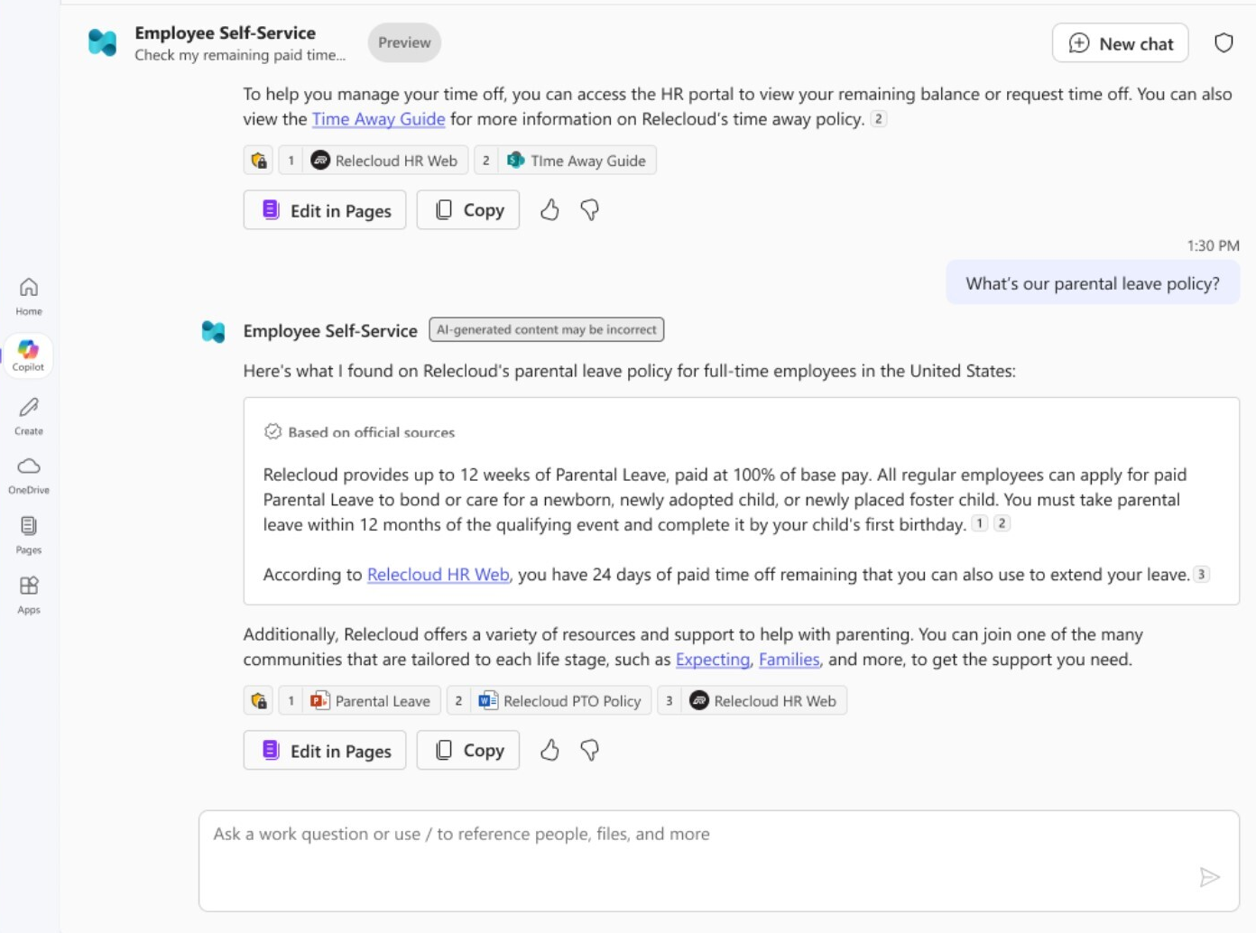



¿Dónde alojar el agente?
Agentes dentro de Microsoft 365
Agentes en la nube de Azure
App Service
Container Apps
Kubernetes Service
Functions
https://developer.microsoft.com/reactor/series/S-1505

Slide 46
Agentes de Microsoft 365 Copilot
Utilice Copilot Studio
o el SDK de 365 Agents para crear agentes integrados en M365.
"Crear y ampliar agentes para Microsoft 365 Copilot"
April 10, Kamal Shree, Paolo Pialorsi (en)
"Creación de agentes de custom engine con Azure AI Foundry y Visual Studio Code"
April 14, Ayca Bas (en)
"Creación de agentes declarativos con Microsoft Copilot Studio y Teams Toolkit "
April 16, Daniel Laskewitz, Garry Trinder (en)

Slide 47
Agentes en la nube de Azure
Azure Functions
"Ampliación de agentes de IA con Azure Functions"
April 24, Eamon O'Reilly, Nick Greenfield (en)
Azure Container Apps
"Creación de agentes de IA de Java con LangChain4j y sesiones dinámicas"
April 17, Brian Benz (en)
"Creación de agentes de IA de Python más inteligentes con intérpretes de código"
April 17, Anthony Chu (en)

Slide 48
Próximos pasos

Slide 49
Hackathon de agentes de IA: Próximos pasos
Regístrate para el hackathon @ aka.ms/agentshack/register
¿Tienes preguntas? Publica en el foro de GitHub o asiste a las horas de oficina de Discord. Únete a la comunidad @ aka.ms/agentshack/discord
¡Asista a más sesiones de expertos en vivo! aka.ms/agentshack-es
¡Envía tu proyecto antes del 30 de abril a las 11:59 p. m. PT!
Notes:
Josh: Hi everyone, hope you enjoyed today's session! If you aren't registered for the AI Agents hackathon yet, register now at aka.ms/agentshack and start hacking on the agent of your dreams.
Pamela: If you have any questions along the way, post in our discussion forum or attend live office hours in Discord. And of course, make sure to join our upcoming live streams to keep learning about agents.
Josh: Once your project is ready, submit it before April 30th at 11:59PM PT to be eligible for our prizes. Thanks for joining!

